Slide 1
Webhosting
2020
Web hosting service
Reporter：7117201 姜子玥
Teammate：71Y17106岑惠儿
2020 Presented by Jiang Ziyue

Slide 2
1
What is Web hosting service?
2
Classifications of web hosting service
CONTENTS
3
Implementation of web hosting services
4
Security & web hosts

Slide 3
PART 1
What is web hosting service ?
In this part, I will tell you the definition of web hosting and the advantages of it
2020 Presented by Ziyue Jiang

Slide 4

Background
Background
Web pages can be opened directly on local computer
How can it be seen worldwild ?
Tianqi PPT
Presentation Designer
Senior Student
Proficient In PPT
Web hosting!!!
Video Design

Slide 5
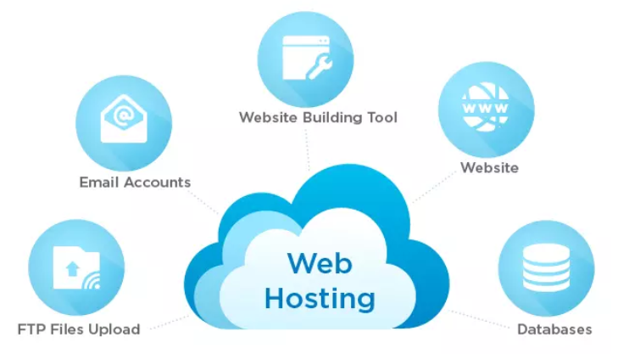
Web hosting service
A type of internet hosting service
Make website of individuals or organizations accessible
DEFINITION

Slide 6
Advantages
CONVENIENCE
RELIABILITY
DATA STORAGE
Clients don't need to own the necessary infrastructure required to operate the website.
Web hosts provide some ways to protect your website from being attacked.
Web hosting service providers offer system resources.

Slide 7
PART 2
Classifications of web hosting service
In this part, I will tell you four classifications of web hosting service.
2020 Presented by Ziyue Jiang

Slide 8
Classifications
Shared web hosting service
Dedicated hosting service
Shared web hosting service refers to a web hosting service where many websites reside on one web server connected to the Internet.
A dedicated hosting service is a type of Internet hosting in which the client leases an entire server not shared with anyone else.
Cloud hosting
Clustered hosting
Cloud hosting is a new type of hosting platform based on clustered load-balanced servers and utility billing.
Clustered servers are a perfect solution for high-availability dedicated hosting, or creating a scalable web hosting solution.

Slide 9
PART 3
Implementation of web hosting services
In this part, I will present two of the hottest web hosting implementations.
2020 Presented by Ziyue Jiang

Slide 10
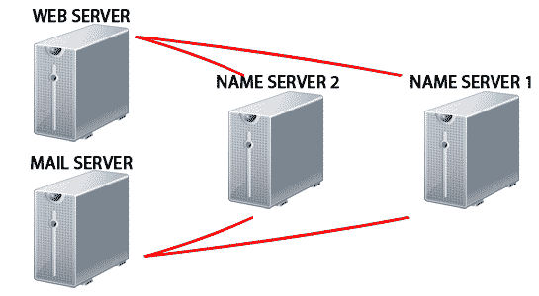
Shared web hosting services
IP based
Each virtual host has a different IP address
The web server is configured with multiple physical network interfaces or virtual network interfaces on the same physical interface.
The web server software uses the IP address the client connects to in order to determine which website to show the user
Name based
The virtual hosts serve multiple hostnames on a single machine with a single IP address
The server uses this information to determine which website to show the user

Slide 11
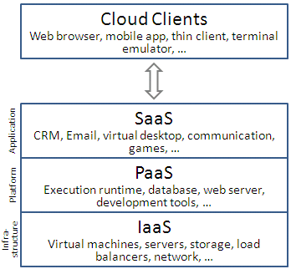
Cloud hosting
Three standard models
Infrastructure as a service（IaaS）
Platform as a service (PaaS)
Software as a service (SaaS)
IaaS: provide high-level APIs used to dereference various low-level details of underlying network infrastructure
PaaS： offer a development environment to application developers.
SaaS：users gain access to application software and databases.
Cloud hosting layers

Slide 12
PART 4
Security
In this part, I will present some ways web hosts use to guarantee the safety of web hosting and the current market of web hosting service.
2020 Presented by Ziyue Jiang

Slide 13
Guarantee safety
No free hosting service
Free hosting accounts are often attacked by hackers
A host that offers cost-free promotional hosting do so only for known clients, and it is kept on a separate network to prevent users from setting up malicious sites.
Reliable firewall
The firewall should block any threats to the server
Specific software
All hosting companies should install specific software that can defend DDoS attacks on their server networks
Limit the use of executable commands
These commands can be used by account holders to access files throughout the server

Slide 14
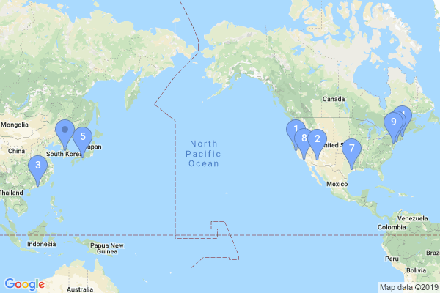
Map location
Top five web hosters
Yahoo Web Hosting
GoDaddy
Tencent Cloud
BlueHost
Telecom-Egypt

Slide 15
Web hosting
THANKS
Reporter：71117201姜子玥
2020 Presented by Ziyue Jiang

